Slide 1
Home Brewing Made Quick and Easy
Keith Wedinger
Director, Technology Solutions and “Beer Snob” at Leading EDJE

Slide 2
Basic Skill List
Can you measure liquids and solids (i.e. follow a basic cooking recipe)?
Can you boil water?
Can you clean and sanitize?
Can you measure temperature?
Can you siphon liquid using a plastic tube?
If YES, they you can brew beer at home!

Slide 3
Basic Equipment List
Home brewing kit - http://goo.gl/qvJncl
7.8 gallon fermenting bucket
6 gallon glass carboy
Thermometer
Drilled stopper
Hydrometer
Bottling spigot
Siphon and vinyl tube
Bottle capper
Airlock
Bottle Brush
22 quart boiling pot
50 12oz bottles
Metal strainer
Funnel

Slide 4
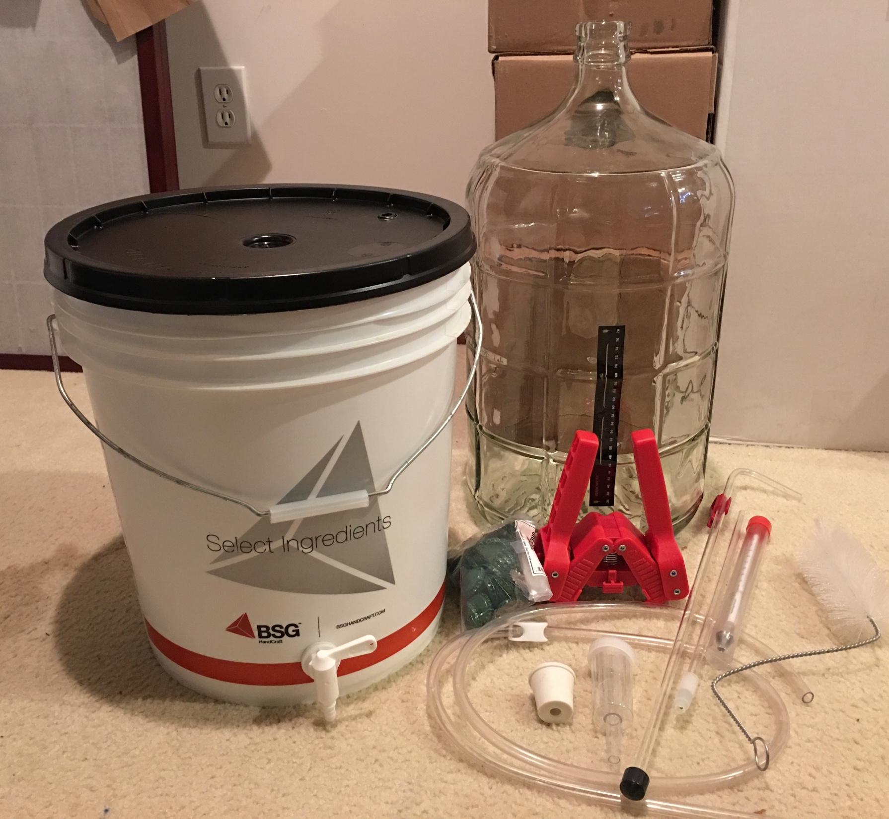
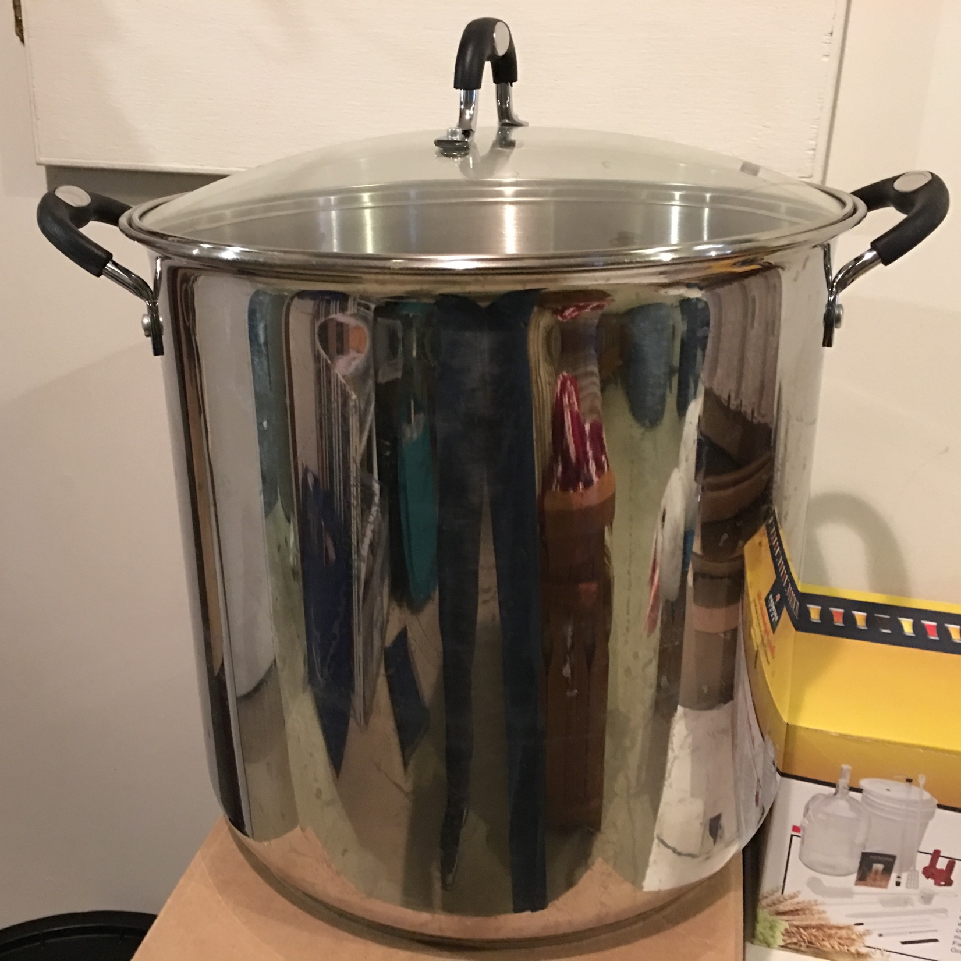

Slide 5
Ingredients
Barley
Hops
Yeast
Water
But what type of barley, hops and yeast? And how much?

Slide 6
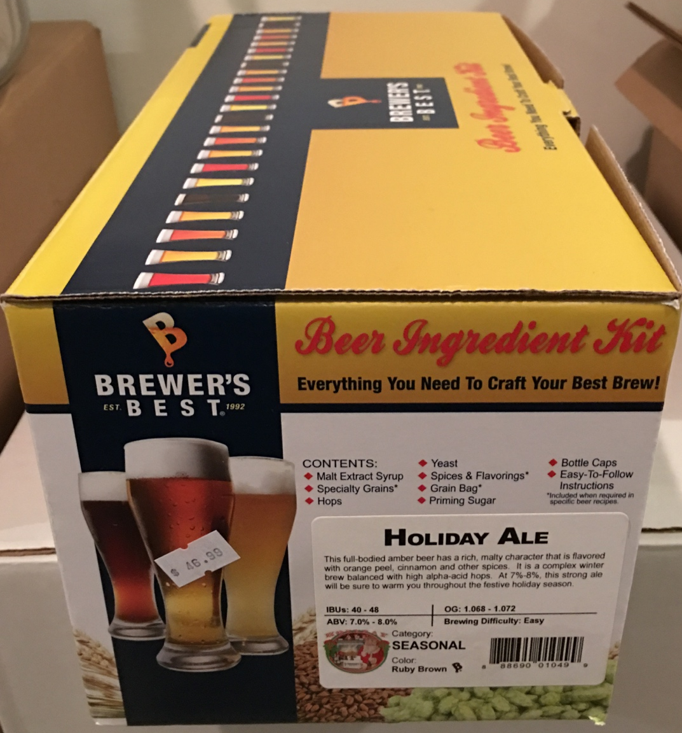
Beer Ingredient Kits
Includes everything you need for the style you want to brew
Includes easy to follow step by step instructions
Indicates difficulty level

Slide 7
Brewing
Clean, sanitize and rinse everything that will touch your beer – 1 to 2 hours
Special sanitizer not required. Use bleach / water mixture of 4 to 6 oz. per 5 gallons of water.
Cook your wort (the water, barley and hops mixture) – 2 hours
Cool your wort to fermenting temperature (approximately 70° F)

Slide 8
Brewing
Transfer wort to glass carboy, straining off barley and hops sediment
Add water to achieve desired gravity
Cap glass carboy with drilled stopper and airlock
Place glass carboy in cool place with near constant 70° F temperature

Slide 9
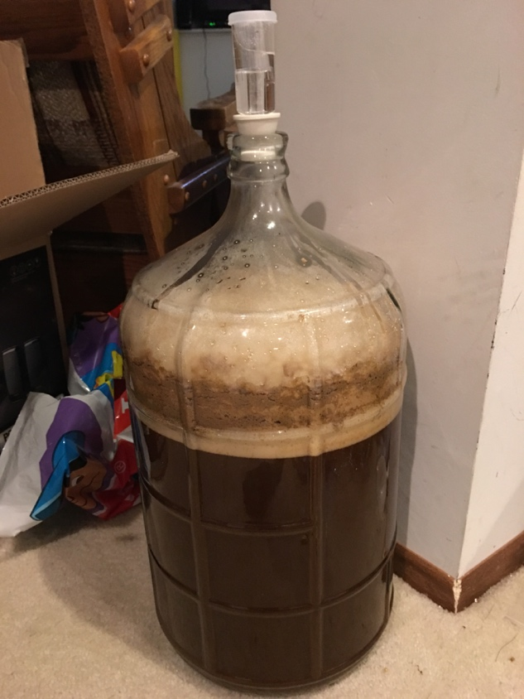
Fermentation
Wait for fermentation to stop - about 7 days, depends on style

Slide 10
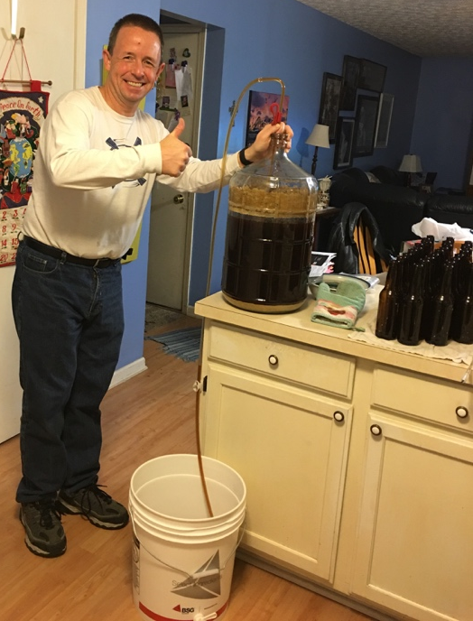
Bottling
Add boiled "sugar water" to bucket
Siphon fermented wort from glass carboy into bucket
Transfer wort from bucket into bottles
Place bottles in cool place with near constant 70° F temperature for 10-14 days

Slide 11
Congratulations!
Your beer is now carbonated and ready to drink.
Cool your beer in your fridge overnight
Uncap and enjoy!
"Relax, don't worry, have a homebrew." – Charlie Papazian from The Complete Joy of Homebrewing (http://goo.gl/QX7Kdj)

Slide 12
Questions
Email
keith.wedinger@leadingedje.com
Twitter
@jkwuc89
Untapped
jkwuc89 (1,256 unique check-ins so far)

